Slide 1
Loan Eligibility Prediction
Nirjala Dahal(24288)
Rabin Bhattarai(24294)
Rishab Shrestha(24298)

Slide 2
Table Of Content
Introduction
Objective
Scope and Limitation
Literature Review
System Design
System Analysis
Implementation
References

Slide 3
Introduction
The purposed "Loan Eligibility Prediction" system is to develop a application that assists users in determining loan eligibility.
This system employs data mining and machine learning techniques to train a Model to determine Eligibility.
If applicant deemed eligible then it's used to determine the suitable loan amount based on their information.

Slide 4
Objectives
Automate the loan eligibility prediction process using machine learning to increase efficiency and provide highly accurate result.
Implement measures to address ethical considerations, such as fairness, accountability, and responsible use of applicant data.
Develop a user-friendly interface for borrowers and lending institution staff, focusing on enhancing the overall user experience.
Develop the system as a decision support tool, providing valuable insights to lending institution staff.

Slide 5


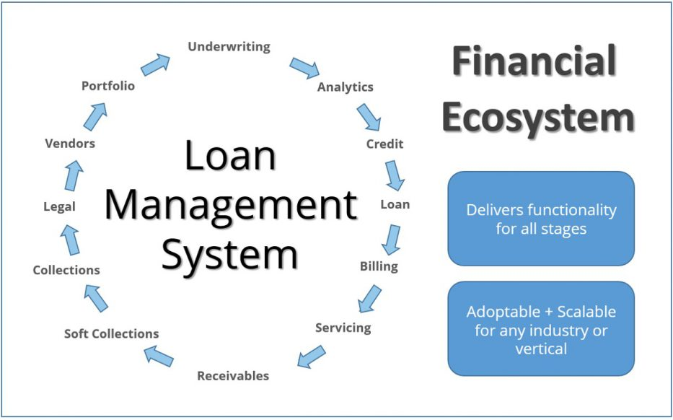
Scope and Limitations
Scope
1. Automation of Loan Eligibility Prediction
2. Accurate Loan Eligibility Prediction
3. Integrate the system seamlessly into the workflow

Slide 6
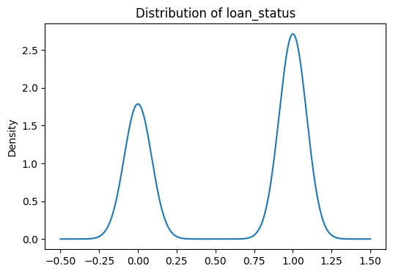
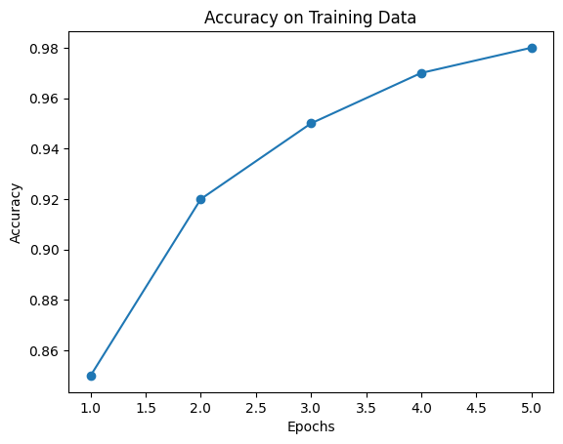
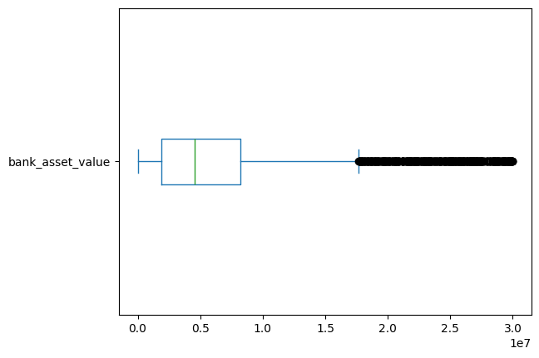
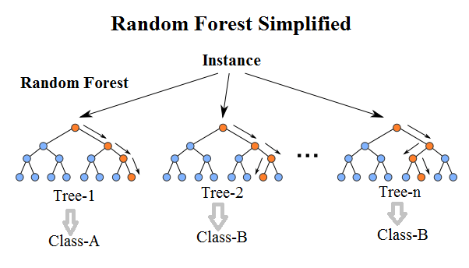
Limitations
4. Performance may be impacted by imbalances in the distribution of loan status
2. Challenges arise in handling rare or extreme cases
3. The interpretability of the Random Forest model is limited
1.System's accuracy is sensitive to training data

Slide 7
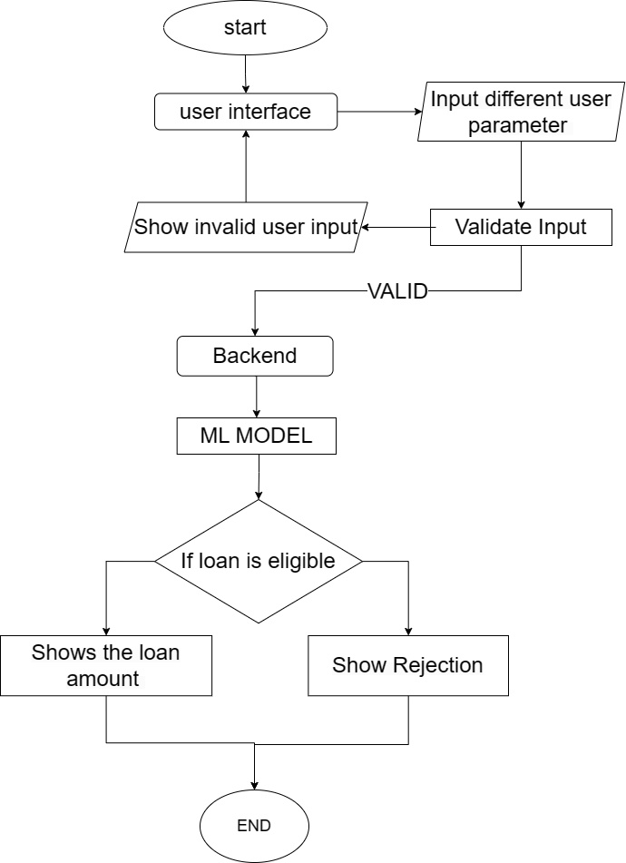
Framework of the model
Fig 1:Framework of Loan Eligibility Predicting System

Slide 8
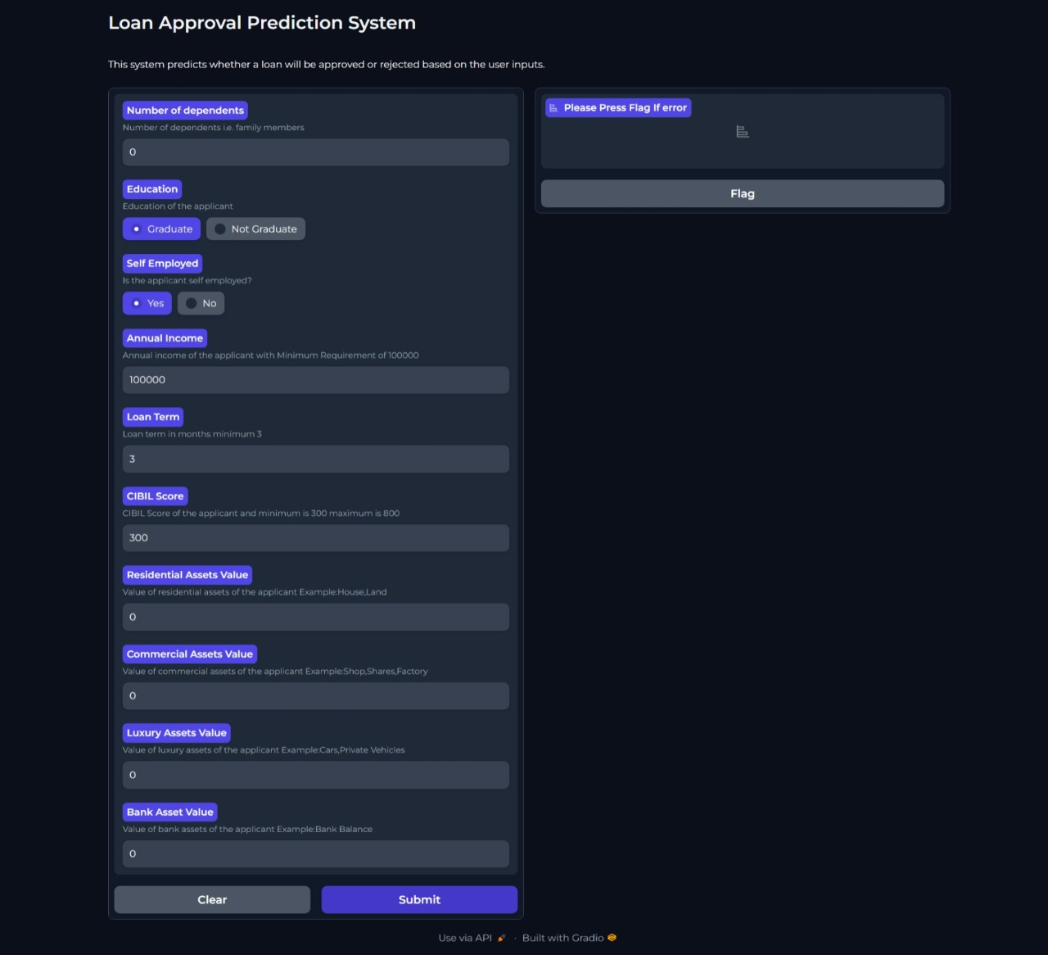
User Form for Loan Prediction Eligibility Application created using Gradio

Slide 9
Literature Review
Literature review summary
From the Papers
“A study on predicting loan default based on the random forest algorithm,”
“Loan Prediction using Decision Tree and Random Forest,"
"Loan Default Prediction on Large Imbalanced Data Using Random Forests,”
We found out that the Random Forest Algorithm is superior and provides better performance and efficiency

Slide 10
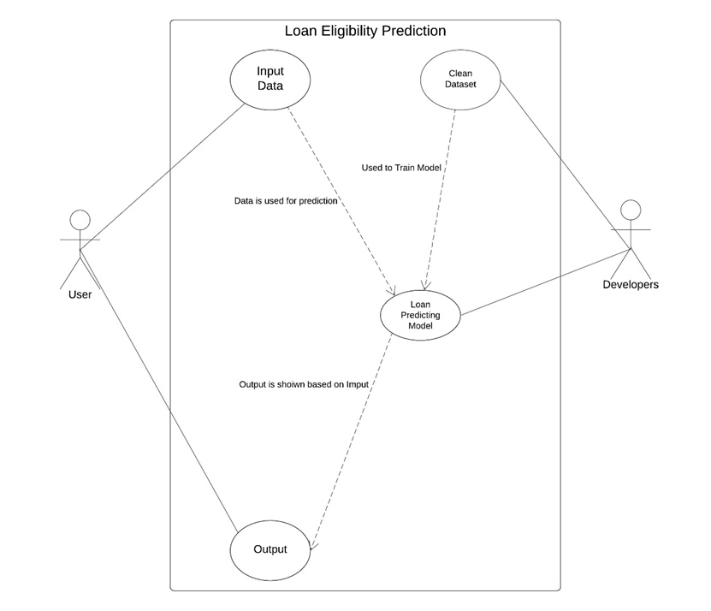
Use Case Diagram
Fig 2: Use Case Diagram

Slide 11
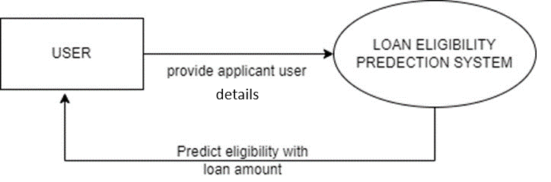
System Design
Level-0 DFD
Fig 3: Level-0 DFD

Slide 12
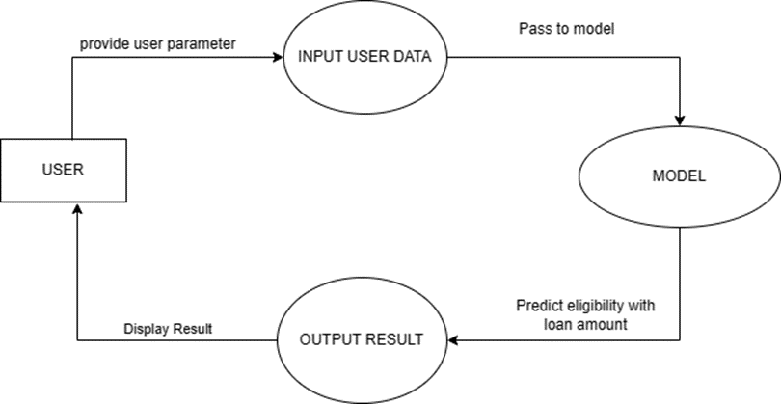
Level-1 DFD
Fig 4: Level-1 DFD

Slide 13
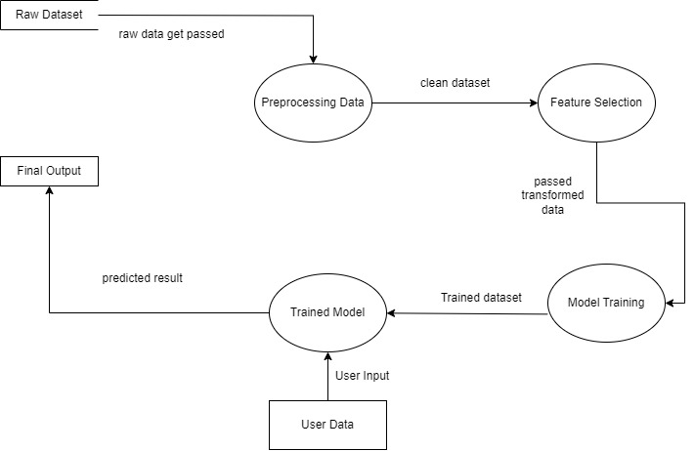
Level-2 DFD
Fig 5: Level-2 DFD

Slide 14
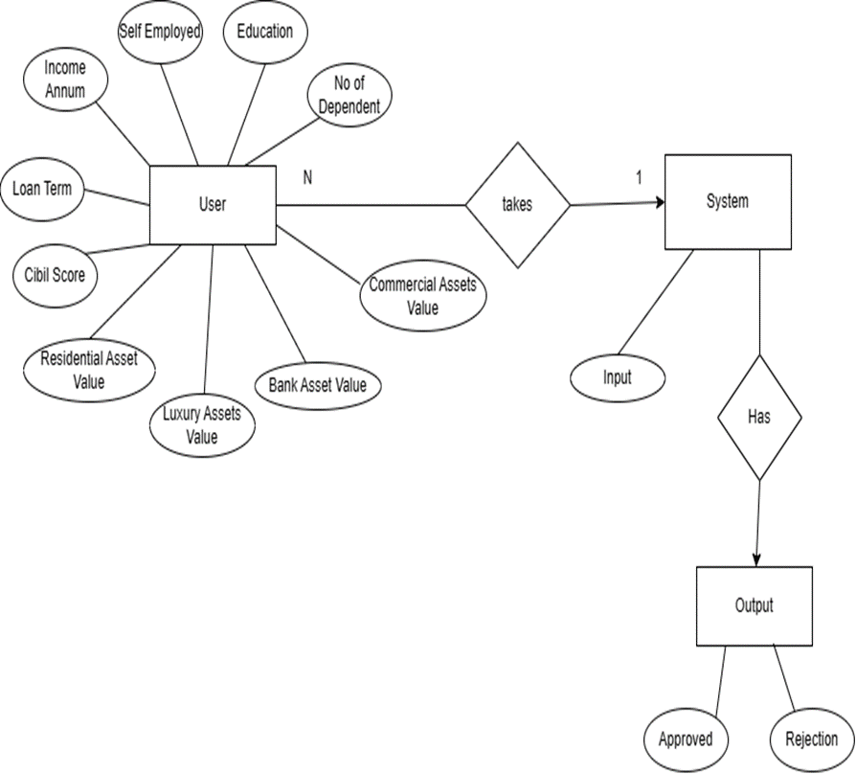
ER Diagram
Fig 6: ER Diagram

Slide 15
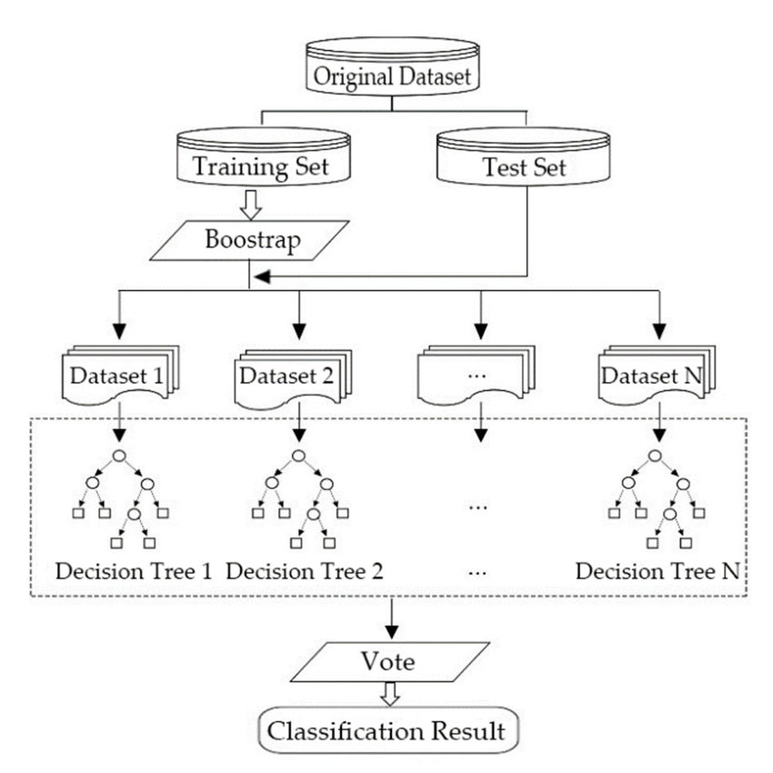
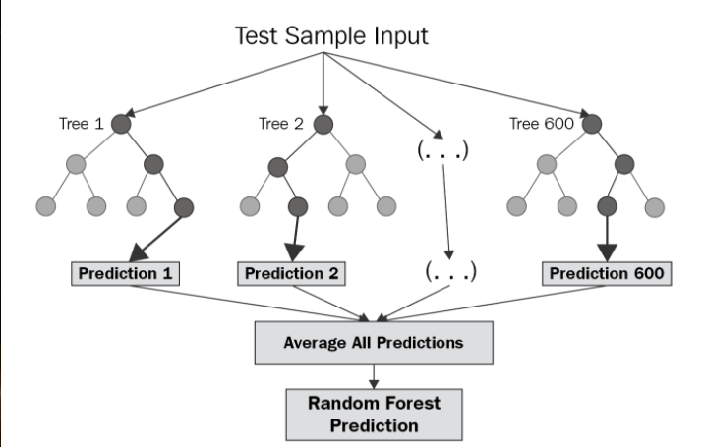
Implementation
Random Forest Algorithm
Fig 7: Random-Forest-Algorithm for Classification
Fig 8: Random-Forest-Algorithm for Regression

Slide 16
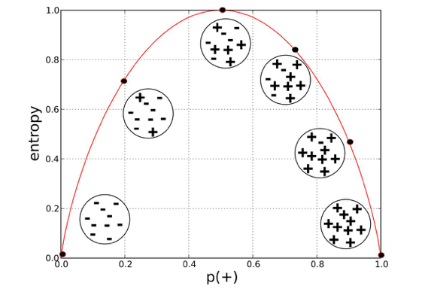

Implementation
Entropy:
Calculates the amount of disorder in a
Loan_Status Column
Where (i) is the number of categories in loan_status (Approved,Rejected)

Slide 17

Implementation
Information Gain
calculates which features helps to separate the target class more perfectly

Slide 18
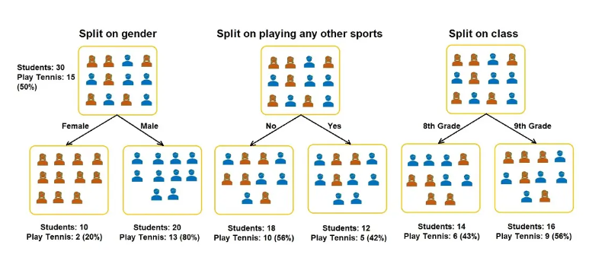
Implementation

Slide 19
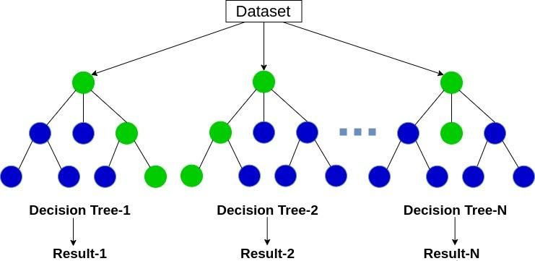
Implementation

Slide 20
THANK YOU

